Slide 1
Smoking-related lung disease in 3D
Dani S. Zander, MD
MacKenzie Professor and Chair, Department of Pathology and Laboratory Medicine, UC COM
Chief of Pathology and Laboratory Medicine, UC Health
Cincinnati, OH

Slide 2

Smoking-Related Lung Diseases
Cause
Chronic obstructive lung disease (COPD): emphysema, chronic bronchitis, small airway disease
Lung cancer
Contributor
Bronchitis and pneumonia
Asthma
Some interstitial lung diseases

Slide 3
COPD
In the United States….
Up to 5% of people are estimated to have COPD
Main symptom is dyspnea (difficulty breathing) and the presence of chronic or recurrent obstruction to airflow in the lung
Major cause of death and disability throughout the world

Slide 4
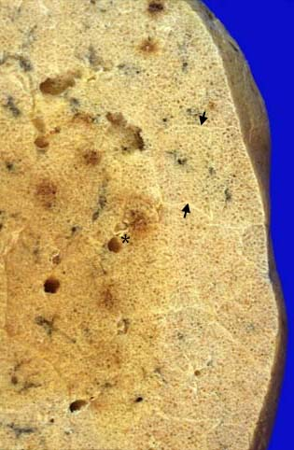
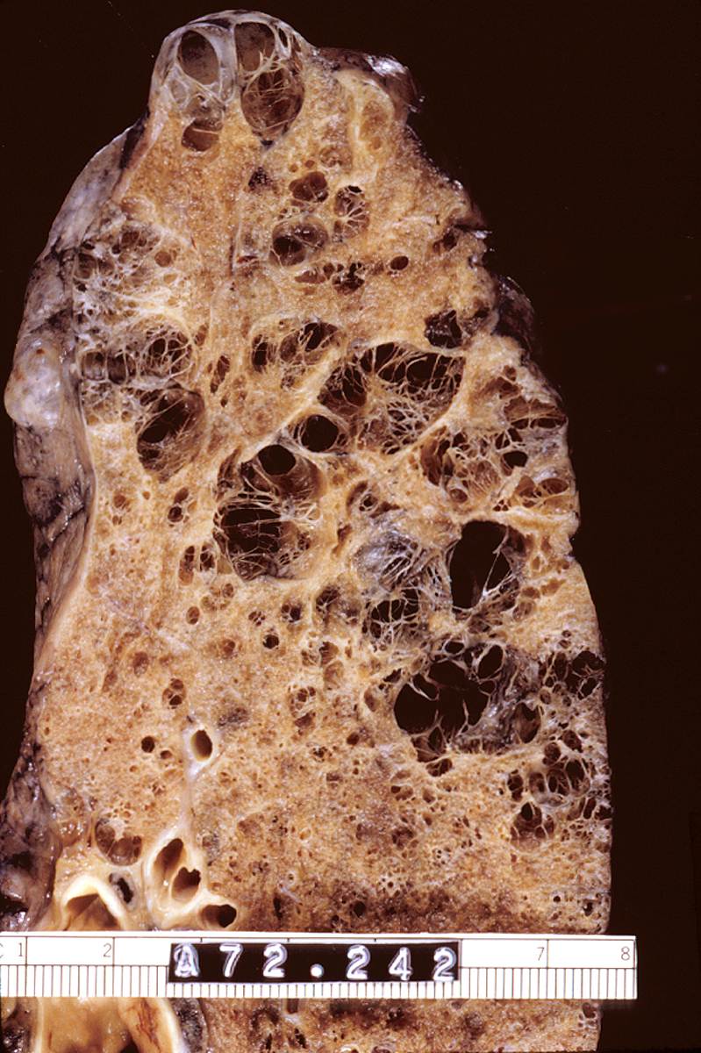
Normal lung
Emphysema
http://pathhsw5m54.ucsf.edu/ctpath/ctpathimages/normdryxx.jpg

Slide 5
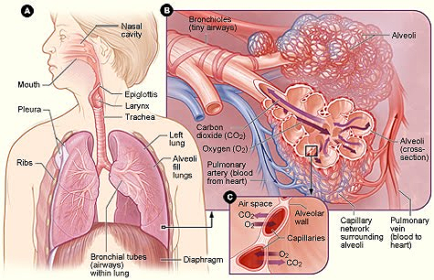
Pathways of inhaled smoke
scienceinterpedia.blogspot.com/2010/05/lungs.html

Slide 6
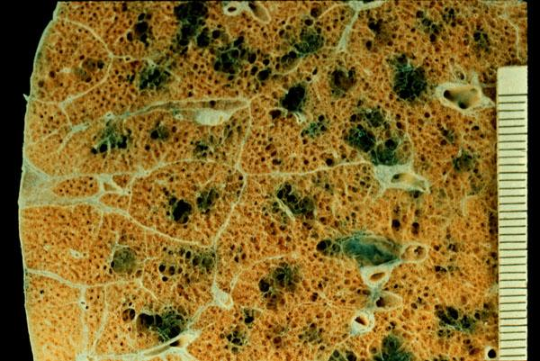
Centriacinar emphysema: enlargement of the central portion of the acinus
The most common type of emphysema and the usual type of emphysema in cigarette smokers
http://www.pathguy.com/lectures/centrilobular.jpg

Slide 7
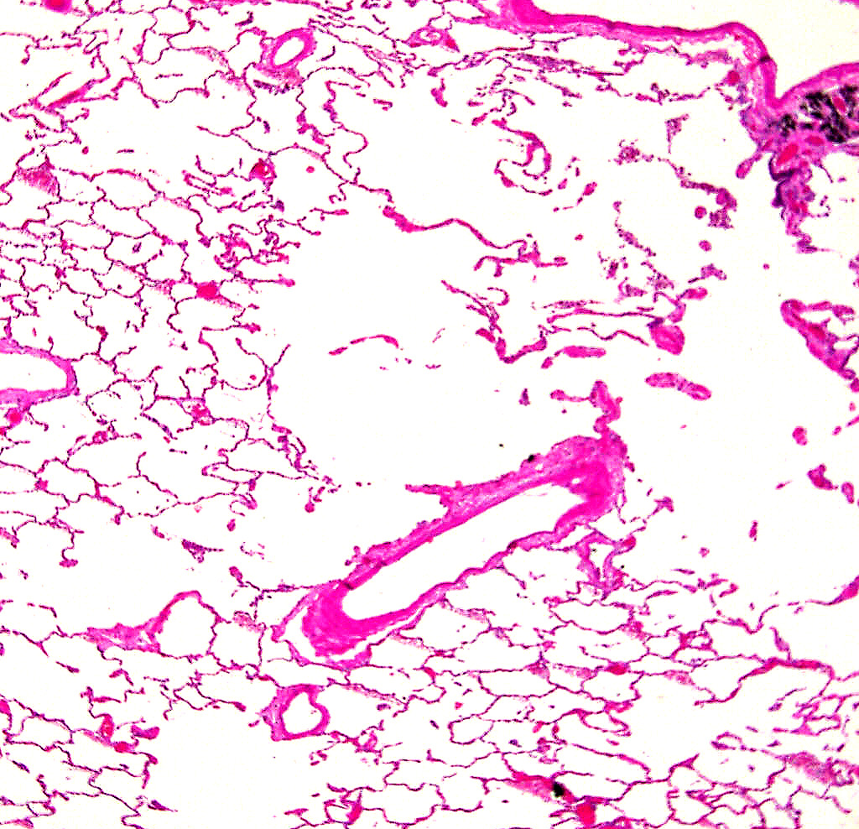
Centriacinar emphysema
Respiratory bronchiole and carbon deposits
Loss (destruction!) of alveolar septa in center of lobule/acinus
Peripheral air spaces look OK

Slide 8
Why does tobacco smoking predispose to emphysema?
Smoke particles → small airways
→ Neutrophils and macrophages (white blood cells) accumulate where the smoke particles land, and release elastase and other proteases → “digestion” of the lung tissues
→ Oxidants (ROS) in smoke and neutrophil granules damage the lung and inhibit antiproteases
Local destruction of small airways
Airspace enlargement
Decreased elastic recoil of the lung and air trapping

Slide 9
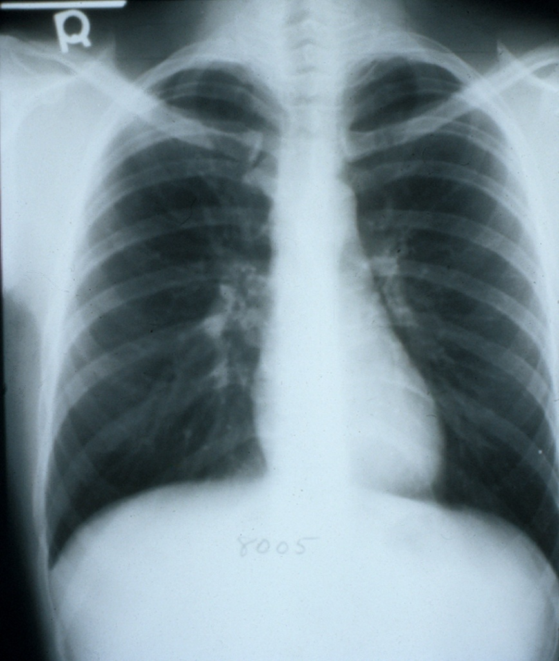
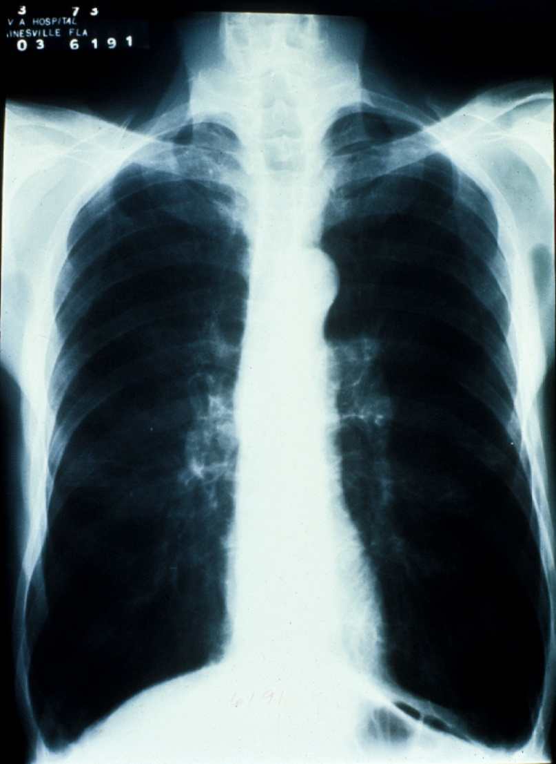
Emphysema
Chest X-ray: hyperinflation, reduced lung markings
Normal
Emphysema

Slide 10
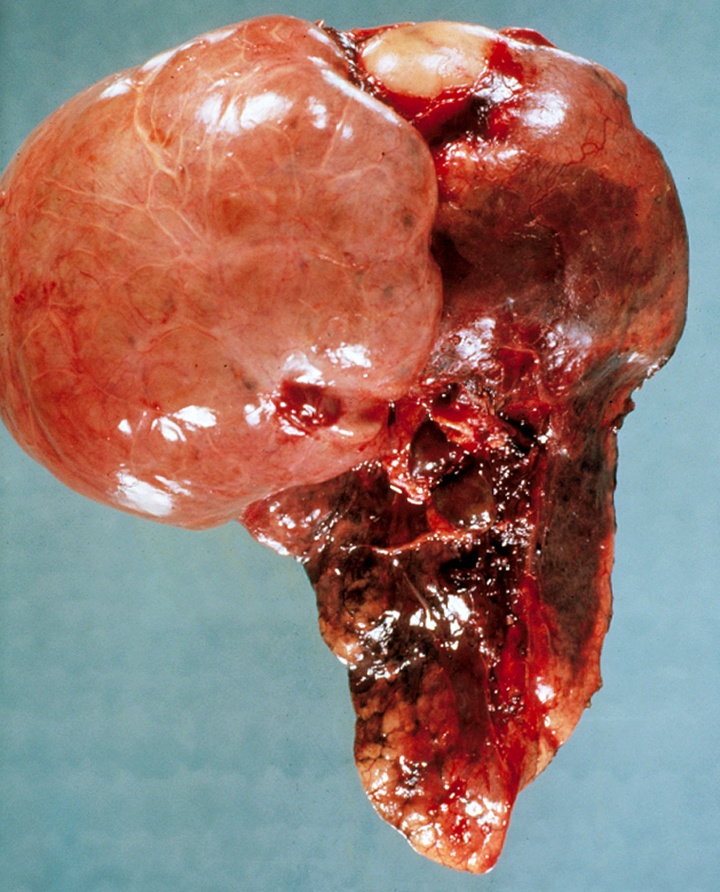
Bullous emphysema

Slide 11
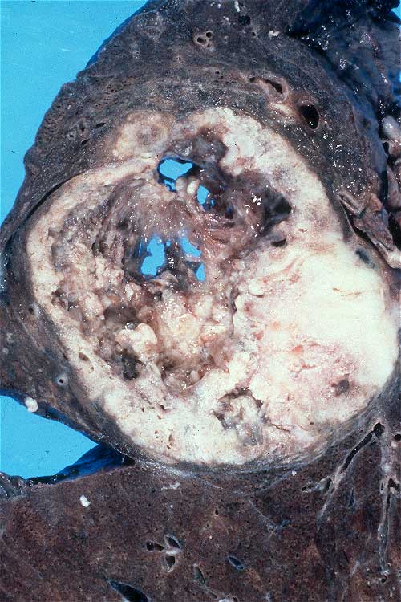
Lung cancer is the leading cause of cancer death in the U.S.
20% of all cancer deaths in men and 11% in women

Slide 12
Etiology/pathogenesis of lung cancer
Tobacco smoking
Industrial hazards: asbestos, radiation, uranium, etc
Air pollution
Genetic influences
Variable risk of lung cancer among smokers
Occasional familial groupings
Common genetic alterations: mutation in EGFR, K-ras, or BRAF or rearrangement in EML4-ALK or ROS1 in adenocarcinomas; loss or inactivation of the p53 tumor suppressor gene; and MANY others
Scarring
Notes:
1

Slide 13
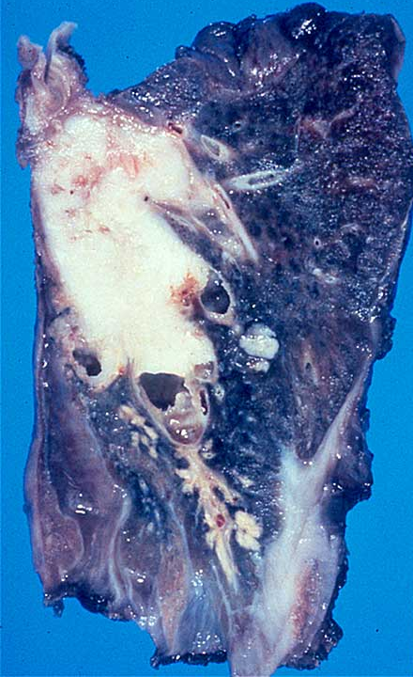
Squamous cell carcinoma
Highly associated with smoking
Arises in the large airways (bronchi)
Grows rapidly and frequently cavitates

Slide 14
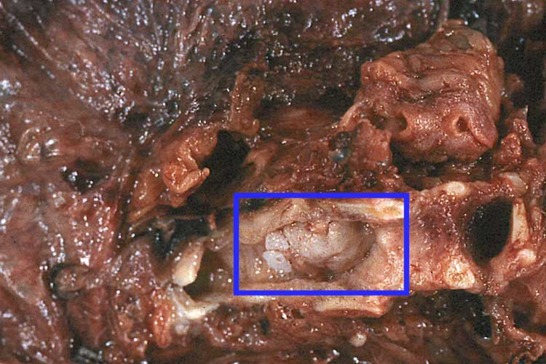

Slide 15
How does normal airway epithelium transform into cancer?
Chemicals in smoke induce ……
A series of genetic and morphologic changes in the cellular composition of airway lining cells (epithelial cells)
Altered cells gain a survival advantage

Slide 16
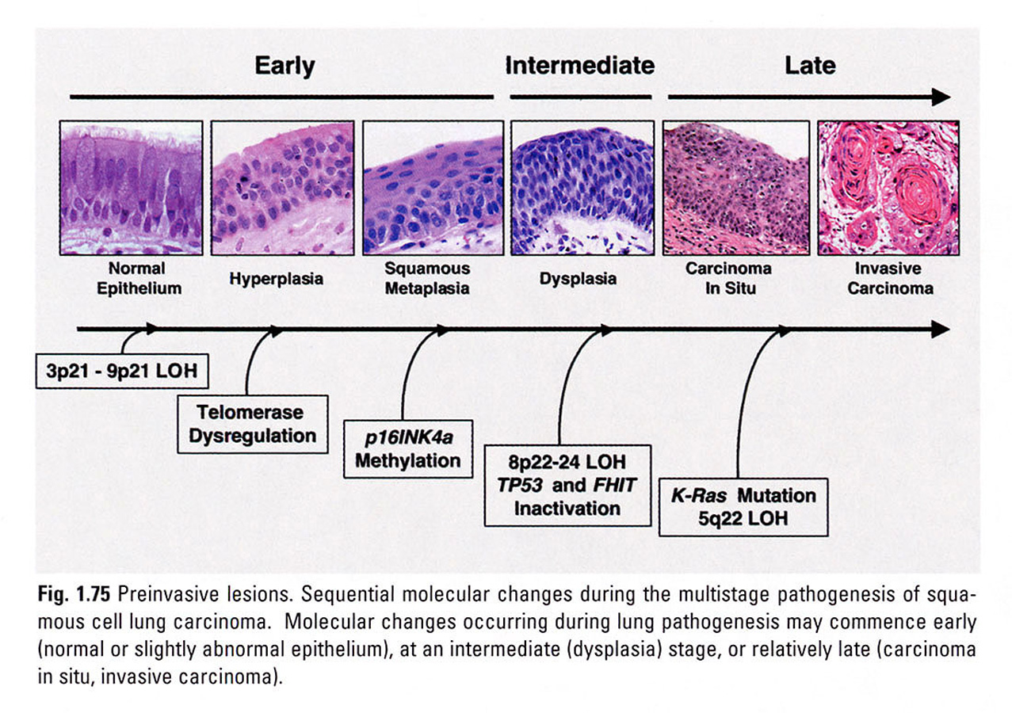
Franklin WA, et al. Squamous dysplasia and carcinoma in situ. In Travis WD, et al. Pathology and Genetics. Tumours of the Lung, Pleura, Thymus, and Heart. Lyon: IARCPress, 2004.

Slide 17
Oncogenes with Therapeutic Relevance in Adenocarcinoma (Adapted from Sholl, 2016)
Gene | Alteration Type | Freq | Characteristics | Therapies
KRAS | Missense mutations at hotspots: Codons 12, 13, 61 | 25% | Smokers >> nonsmokers; enriched in invasive mucinous AC, LCC | Chemotherapy; Clinical trials of MEK inhibitors
EGFR | Missense and insertion-deletion mutations at hotspots in exons 18–21; >90% occur as Ex19del, L858R mutations | 15% | Nonsmokers >> smokers Women > men Enriched in Asian populations | First-line EGFR TKIs: Erlotinib, Gefitinib, Afatanib
ALK | Rearrangements: EML4-ALK, most common | 5% | Nonsmokers >> smokers Younger patients | Multikinase TKIs: Crizotinib, Ceritinib, Alectinib
ROS1 | Rearrangements: CD74-ROS1, SCL34A2-ROS1, EZR-ROS1, FIG1-ROS1 | 1%–2% | Nonsmokers >> smokers Younger patients | Multikinase TKIs: Crizotinib
RET | Rearrangements: KIF5B-RET, CCDC6-RET, NCOA4-RET | 1%–2% | Nonsmokers >> smokers Younger patients | Multikinase TKI trials: Sunitinib, Vandetanib Cabozantinib
BRAF | V600E and other missense mutations at hotspots in exons 11 and 15 | 4% | Smokers > nonsmokers | RAF-MEK inhibitors: Dabrafenib, trametinib
ERBB2 | Small exon 20 insertions; rarely have concomitant amplification | 2% | Nonsmokers >> smokers | HER inhibitor trials: Trastuzumab, Neratinib, Afatinib, Lapatinib
MET | Exon 14 skipping mutations Amplification | 3% | Smokers > nonsmokers Older patients | Multikinase TKI trials: Crizotinib, MGCD-265

Slide 18
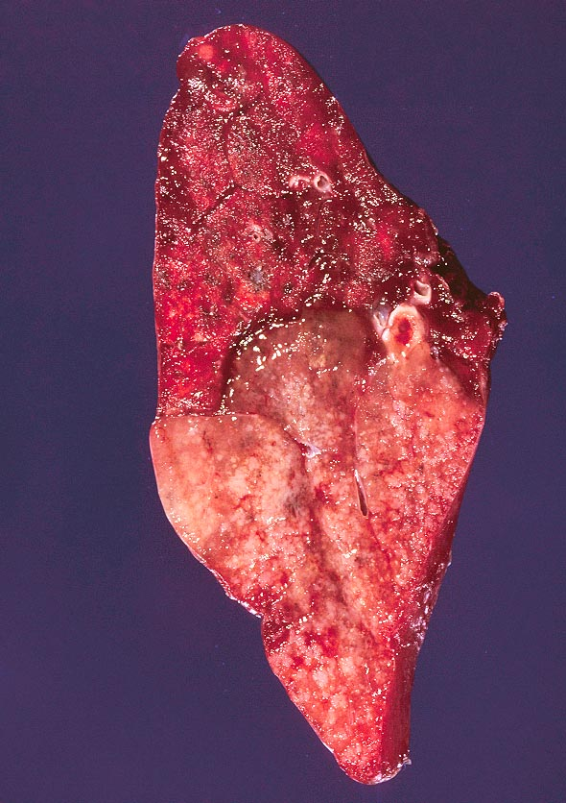
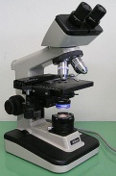
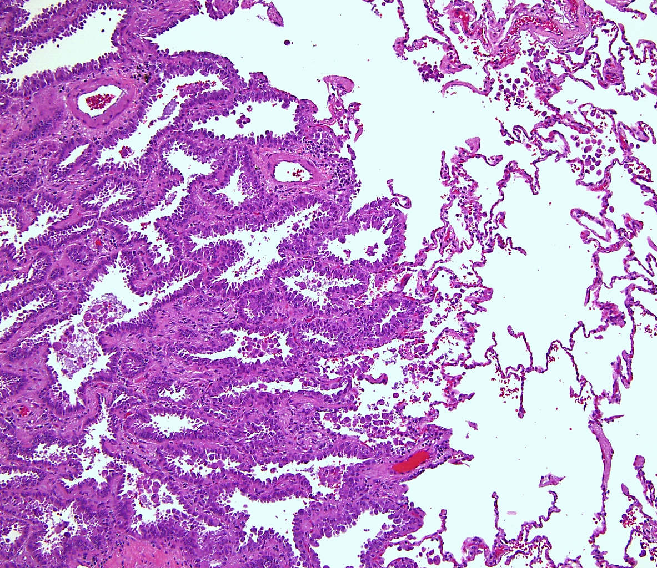
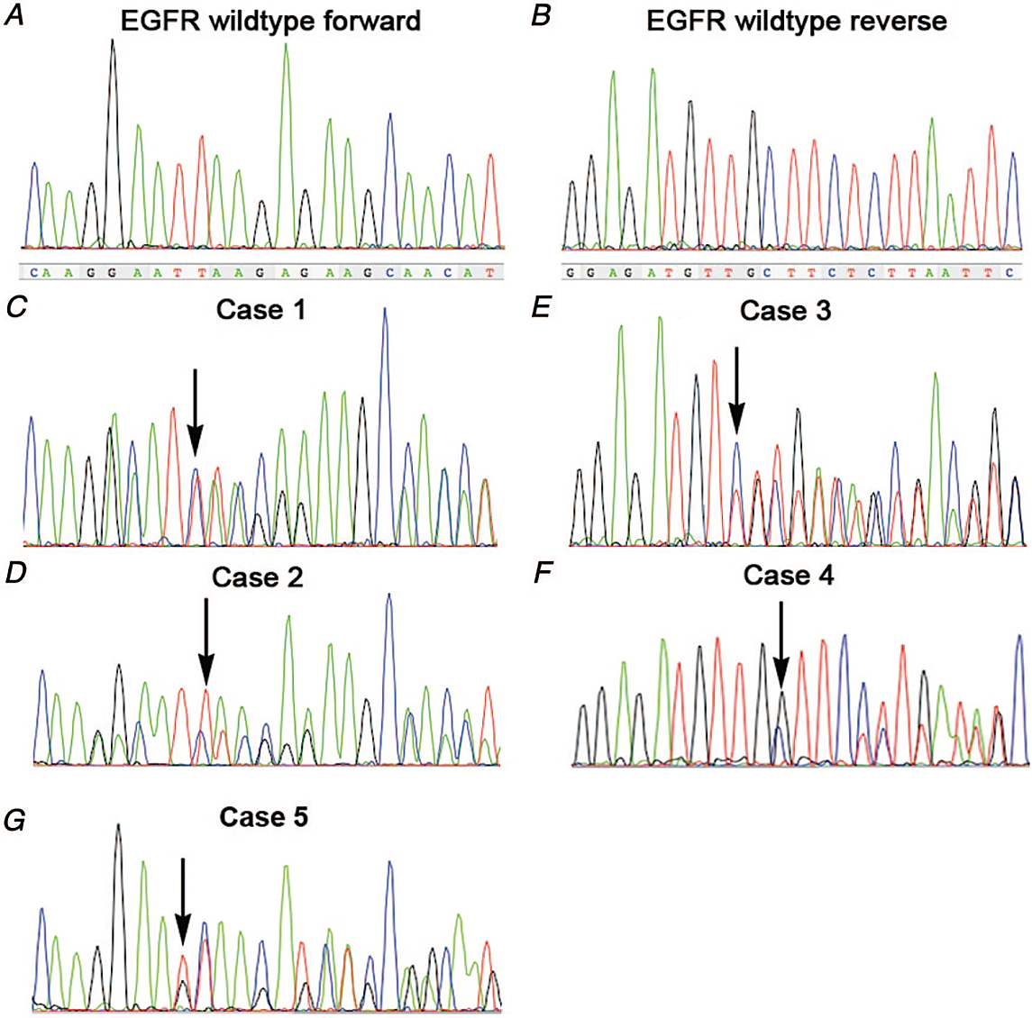
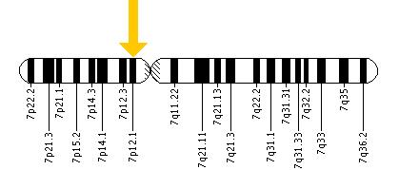
Adenocarcinoma
The epidermal growth factor receptor (EGFR) gene is located on the short (p) arm of chromosome 7 at position 12 (7p12), base pairs 55,086,724 to 55,275,030

Slide 19
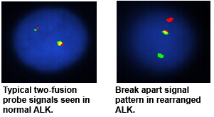
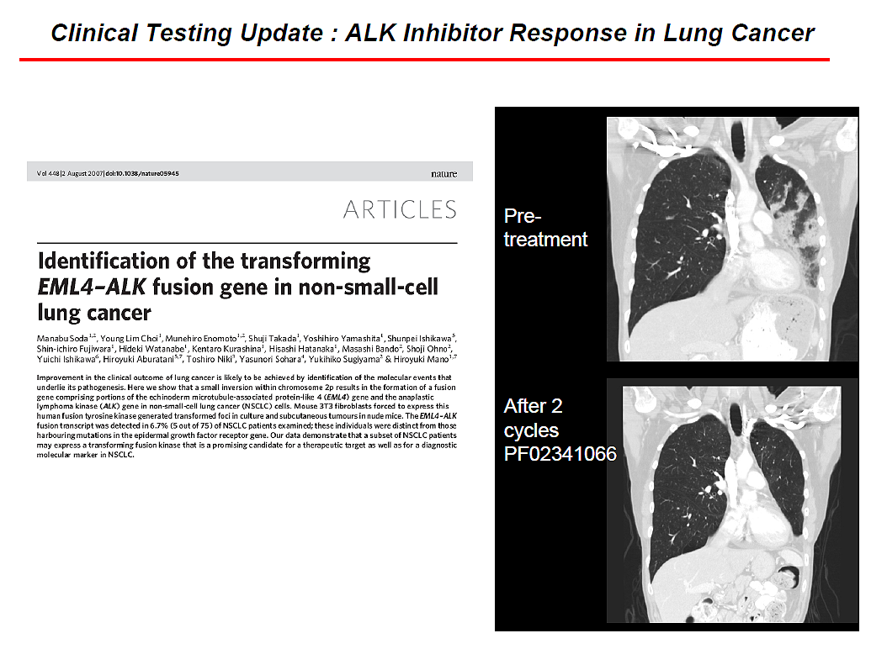
ALK inhibitor response in lung cancer

Slide 20
Instructors
Peter G. Anderson, DVM, PhD
Professor and Director of Pathology Undergraduate Education
Department of Pathology
The University of Alabama at Birmingham
James R. Stone, MD, PhD
Associate Professor of Pathology, Harvard Medical School
Head of Cardiovascular Pathology, Massachusetts General Hospital
Director of Autopsy Service, Massachusetts General Hospital

